Slide 1
ASHWIN S
Artistic style transfer

Slide 2
ARTISTIC STYLE TRANSFER
Artistic style transfer is a fascinating technique that merges the content of one image with the style of another, creating visually appealing and unique compositions.
This process involves applying the statistical properties of a reference artwork (style image) to the content of a target image, resulting in a transformed image that inherits the stylistic features of the reference while retaining the structure and content of the original.
Artistic style transfer algorithms typically leverage deep neural networks, particularly Convolutional Neural Networks (CNNs)

Slide 3


AGENDA
PROBLEM STATEMENT
PROJECT OVERVIEW
END USERS
SOLUTION AND ITS VALUE PROPOSITION
THE WOW IN A SOLUTION
MODELLING
RESULTS
3/21/2024 Annual Review

Slide 4

PROBLEM STATEMENT
Artistic style transfer aims to develop computational techniques that effectively combine the content of one image with the artistic style of another, producing visually appealing and coherent stylized outputs. The challenge lies in designing algorithms that can accurately separate and manipulate the content and style representations of images while preserving the integrity of the original content and faithfully transferring the desired artistic style. Furthermore, addressing issues such as style consistency, content preservation, computational complexity, and subjective aesthetic preferences is essential to advancing the state-of-the-art in artistic style transfer and unlocking its full potential across various applications, including art creation, photography, design, entertainment, and digital media

Slide 5
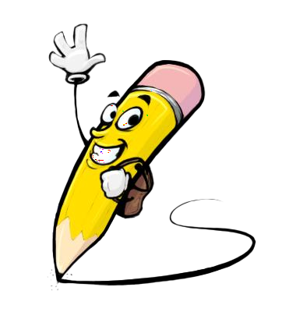
PROJECT OVERVIEW
This project aims to implement and explore various algorithms for artistic style transfer, investigating their effectiveness in generating high-quality stylized images while preserving the original content and faithfully transferring the desired artistic style.
The primary challenge is to develop computational techniques that accurately separate and manipulate the content and style representations of images, ensuring that the resulting stylized outputs maintain the integrity of the original content while embodying the characteristics of the chosen artistic style.
Investigate the impact of various parameters, such as style weight, content weight, and optimization techniques, on the performance of artistic style transfer.
Explore potential applications of artistic style transfer in fields such as art creation, photography, design, entertainment, and digital media.

Slide 6
WHO ARE THE END USERS?
The end users of this system are professionals involved in the hiring process within organizations including ,
Artists and Designers:
Photographers, and
Educators and Students
profiles.
Everyday users who are interested in art, photography, or digital media can explore and experiment with artistic style transfer algorithms to create personalized artworks, stylized images, and visual compositions for personal enjoyment or sharing on social media platforms.

Slide 7

YOUR SOLUTION AND ITS VALUE PROPOSITION
SOLUTION:
The project aims to develop and implement computational techniques for artistic style transfer, leveraging deep learning algorithms and image processing techniques. By exploring various approaches such as neural style transfer, texture synthesis, and variational autoencoders, the project seeks to enable users to seamlessly blend the content of one image with the artistic style of another, producing visually appealing and unique compositions.
VALUE PROPOSITION:
Creative Expression: The project empowers artists, designers, photographers, and content creators to explore new creative possibilities and enhance their artistic expressions through computational techniques for style transfer.
Efficiency and Automation: By automating the process of artistic style transfer, the project streamlines workflows for creating visually striking artworks, designs, and visual content, saving time and effort for users.

Slide 8

THE WOW IN YOUR SOLUTION
The project implements computational techniques for artistic style transfer, enabling users to seamlessly blend image content with diverse artistic styles. Through algorithmic optimization and evaluation, it ensures high-quality stylized outputs while preserving original content integrity. This solution streamlines creative workflows, offering personalized and visually appealing outcomes for artists, designers, photographers, and content creators. . Overall, the project enhances creative expression and visual communication across various domains.
3/21/2024 Annual Review

Slide 9
MODELLIG
Utilizing deep learning architectures such as Convolutional Neural Networks (CNNs), our approach aims to extract and manipulate content and style representations separately.
Through iterative optimization techniques, we refine the model parameters to minimize the content and style distances, ensuring faithful style transfer while preserving original content features.
By evaluating the model's performance using quantitative metrics and qualitative assessments, we validate its effectiveness in generating visually appealing and coherent stylized outputs.
This modeling approach serves to streamline creative workflows, offering versatile tools for artists, designers, photographers, and content creators to explore new realms of artistic expression and visual communication.

Slide 10
RESULTS
Demo Link

